Slide 1
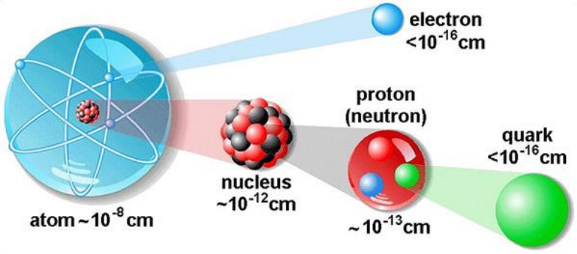
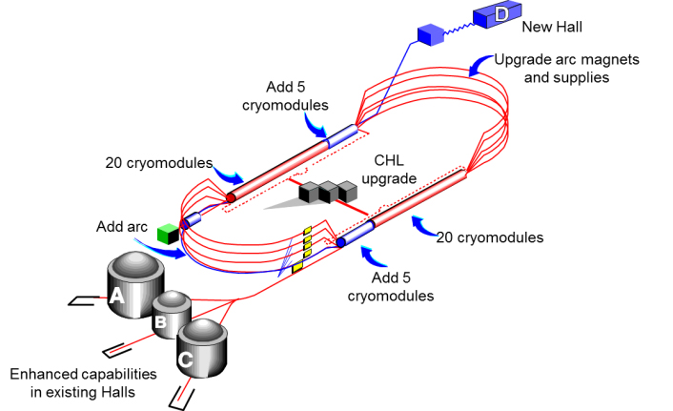


Studies of L-T Separated Kaon Electroproduction
Richard Trotta
Spokespeople: Tanja Horn, Garth Huber, Pete Markowitz

Slide 2
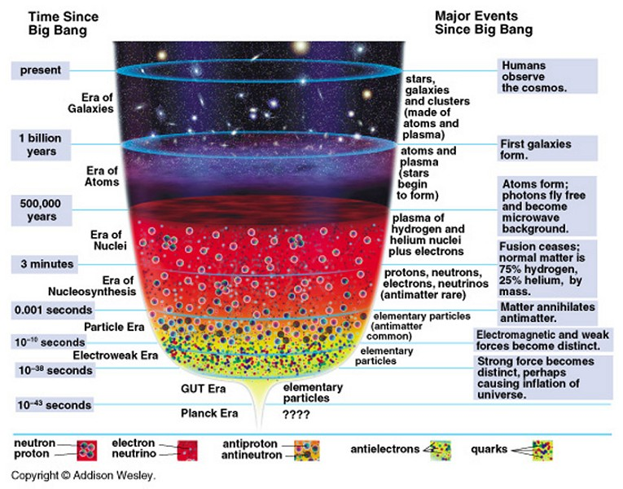
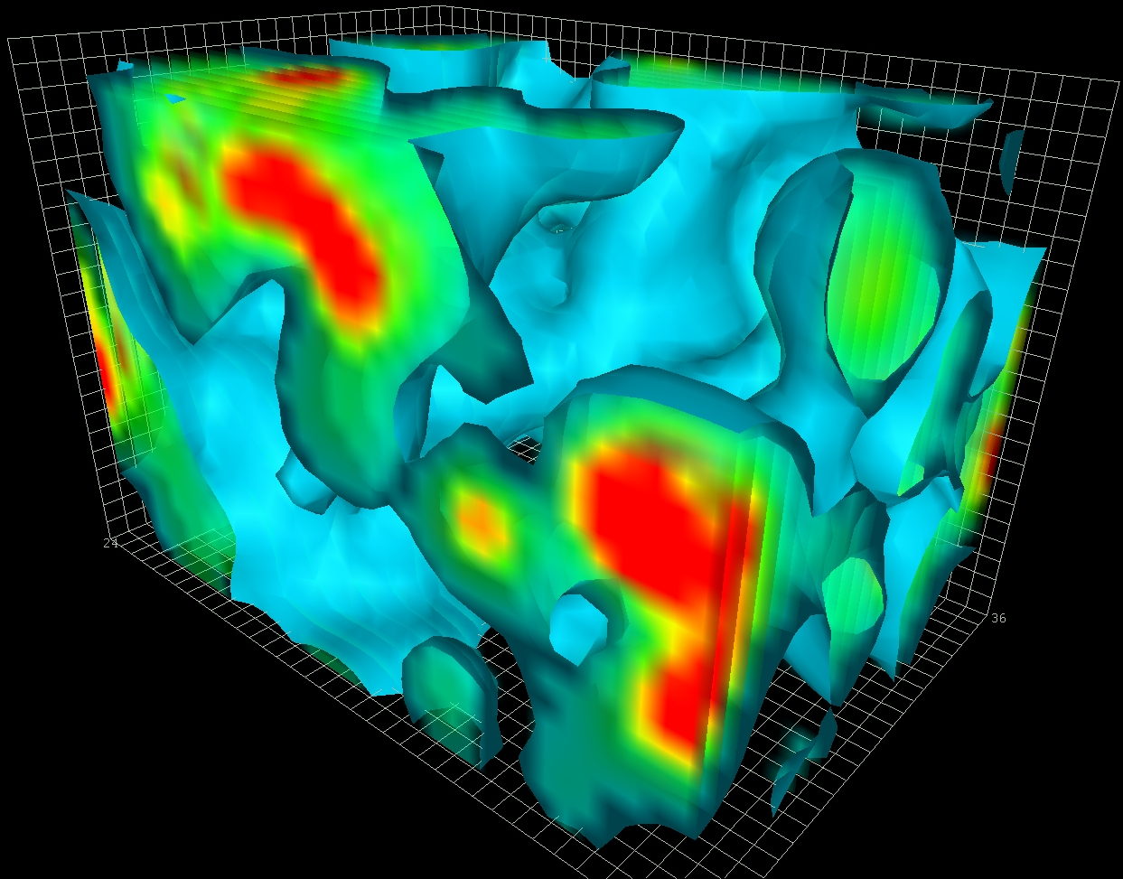
Particle and Nuclear Physics
Nuclear physics seeks to
Understand the fundamental structure of visible matter (i.e. quarks, gluons)
Understand how hadrons (i.e. mesons, nucleons) are formed

Slide 3
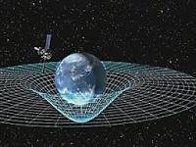
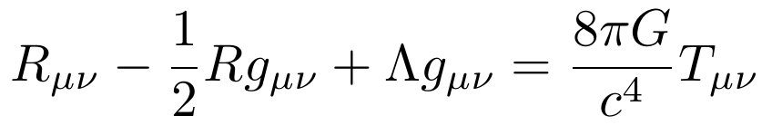
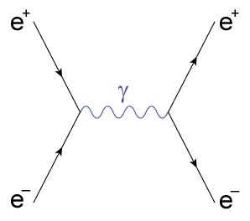
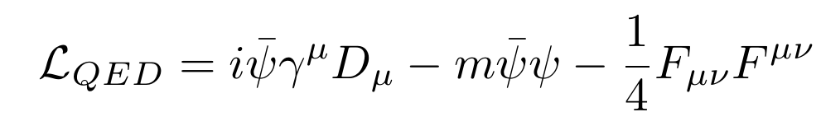
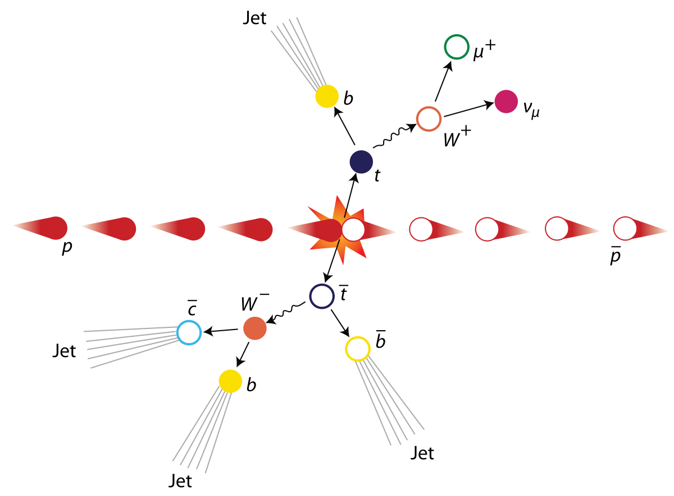
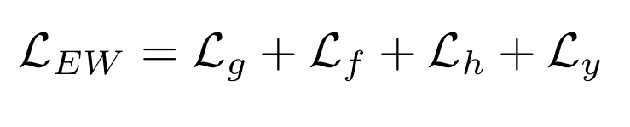
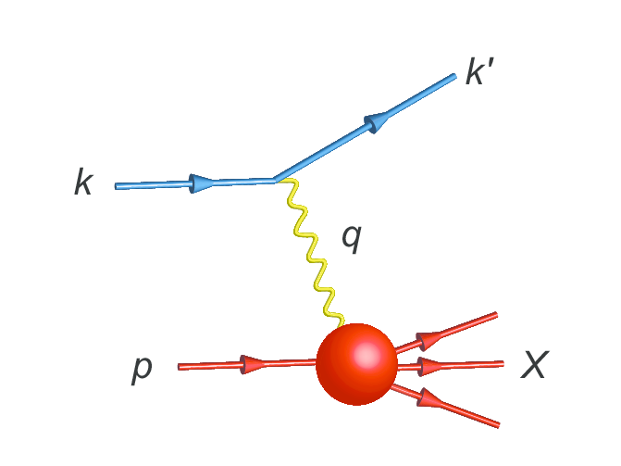
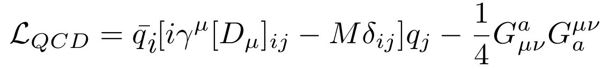
Four Fundamental Forces
Gravity, general relativity
Electromagnetism, quantum electrodynamics (QED)
Weak Force, electroweak theory (EW)
Strong Force, quantum chromodynamics (QCD)

Slide 4
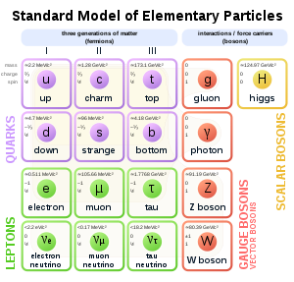
Try All Six Flavors!
Quarks, similar to leptons, have six flavors
Everyday matter is made of protons and neutrons, which are made of the light up and down quarks
The strong force mediates massless gluons between quarks, like how photons are the mediating force carrier between charged particles
These gluons interact with the up and down quarks, rapidly changing colors to make what we see as protons and neutrons
Hadrons are color-neutral bound states of quarks
three valence quarks (baryons)
valence quark-antiquark pair (mesons)

Slide 5
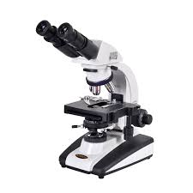
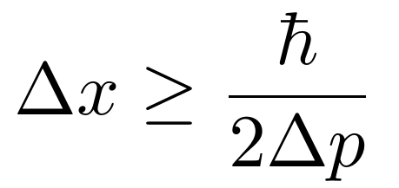
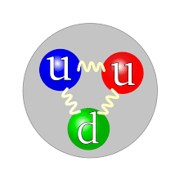
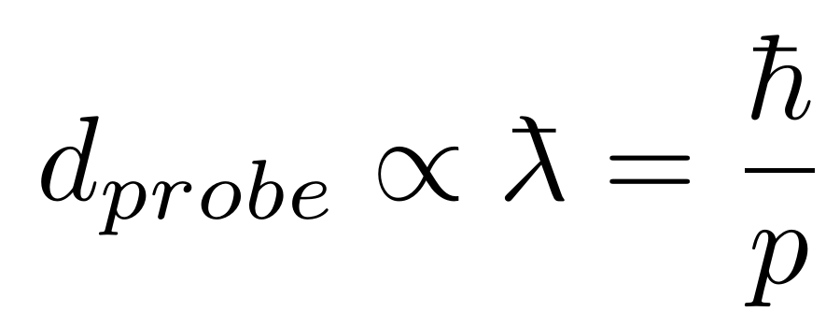
Is the Proton Pointlike?
A microscope uses photons to see tiny objects, can we do something similar to view the proton?
Very very very high momentum photons would be needed
Why not use a similar probe with easier to access momenta?
Let’s use the de Broglie Wavelength for motivation
The proton interacts electromagnetically, so we use a lepton (e.g. electron) with a high momentum as a probe.

Slide 6
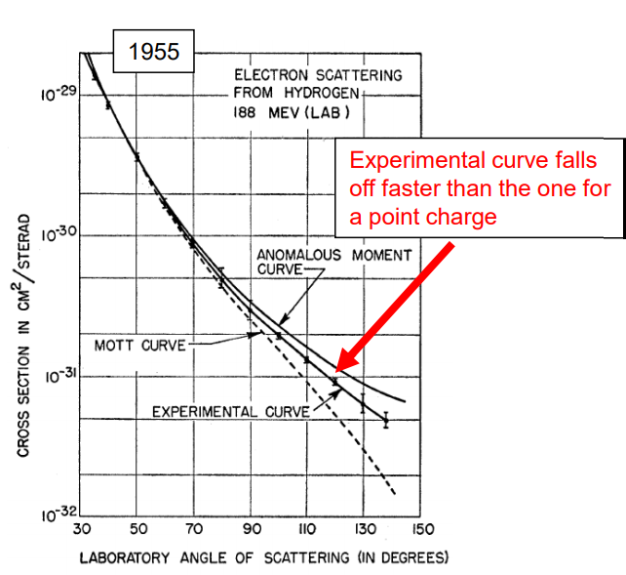
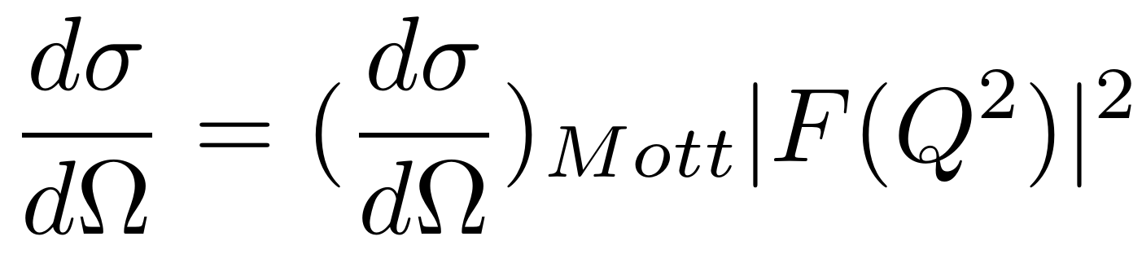
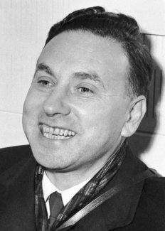
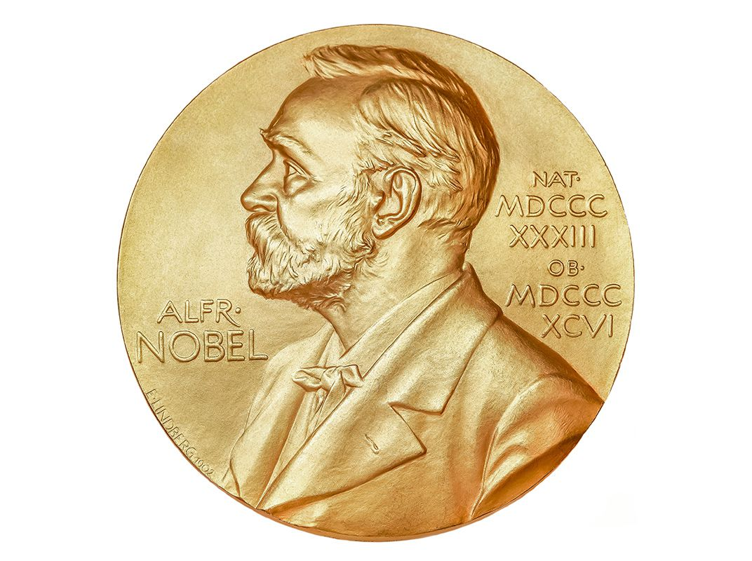
Proton is Not Pointlike
1950’s: The exploration of the internal structure of the proton began with Hofstadter’s experiments
Point-like cross section
Form Factor

Slide 7
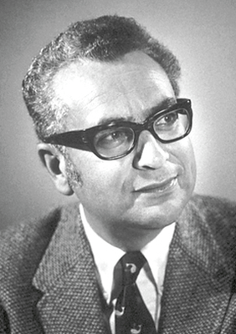
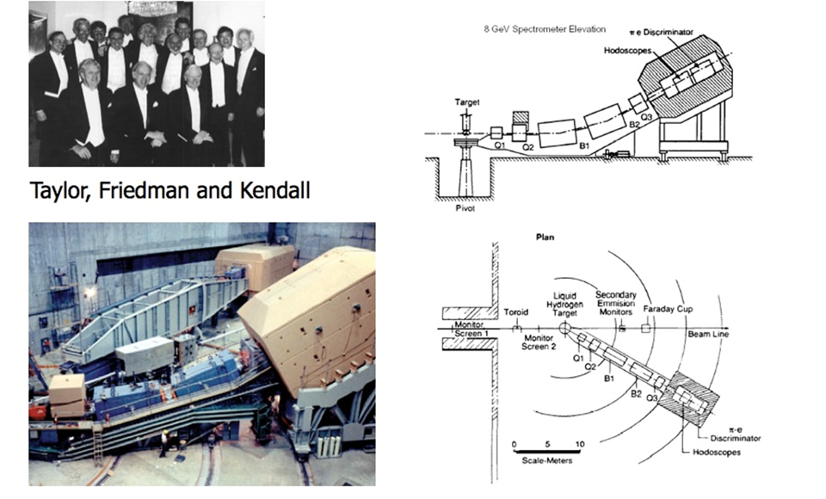
Foundations of Proton’s Internal Structure
1960s: The proton’s internal structure was described by the quark model
Proposed by Murray Gell-Mann and George Zweig
Point-like particles called quarks were what the proton was made of
1968: Deep Inelastic scattering (DIS) at SLAC which observed scaling. The proton’s internal structure is composed of point-like charged particles.
1972: QCD is developed
Gell-Mann
(R.I.P. 5/24/19)
Notes:
Fig. 1: Integrating over the fractional momentum x, one obtains the form factors.
Fig. 2: Even in the chiral limit the onset of quark mass would be present

Slide 8
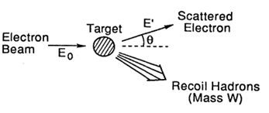
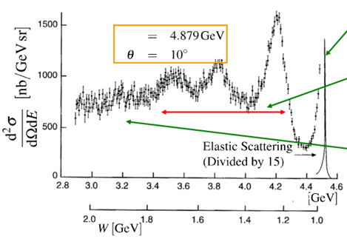
Types of Scattering
Elastic Scattering: proton stays intact
The initial and final states are the same, only the momenta change.
Static image!
E
Inelastic Scattering: proton gets excited, produces excited states or proton’s resonances
Deep Inelastic Scattering: proton breaks up and end up with a many particle final state
Dynamical image!
E

Slide 9
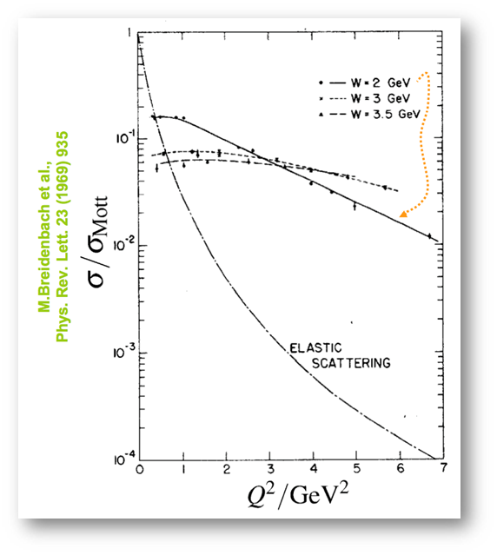
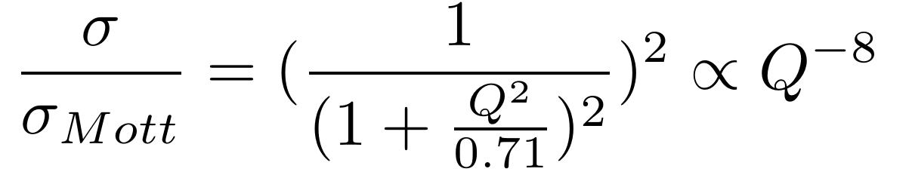
Exploring the Inner Proton
Deep Inelastic Scattering: cross sections almost independent of transferred momentum, Q²
i.e. “Form factors” -> unity
Scattering off point-like objects within proton
Inelastic Scattering: cross sections weakly dependent on Q²
Elastic Scattering: falls off rapidly with Q² due to proton not being point-like

Slide 10
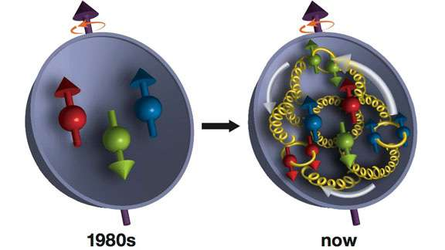
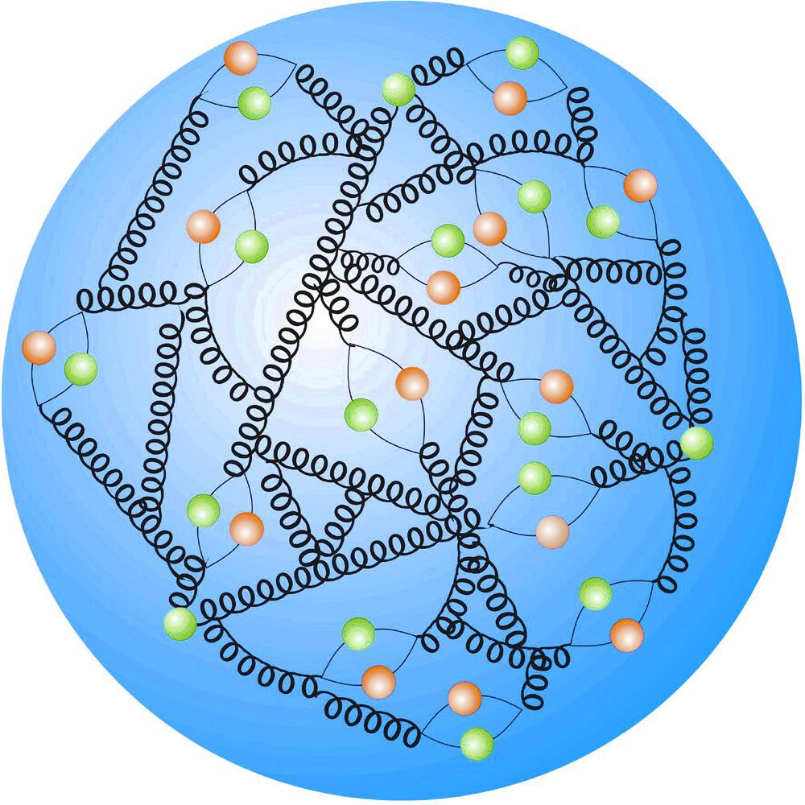
Mysteries of the Proton
Proton spin puzzle
1980s: experiments performed by the European Muon Collaboration
They showed that the contribution of quark spin to the total spin of the proton was between 4-24%
This was later confirmed by other experiments to be around 30%
Origin of hadron mass
The total is more than the sum of the parts, there's more than quarks making up the substructure
As we will see this is due to a quark-gluon sea and gluon dynamical interactions
Notes:
Fig. 1: Integrating over the fractional momentum x, one obtains the form factors.
Fig. 2: Even in the chiral limit the onset of quark mass would be present

Slide 11
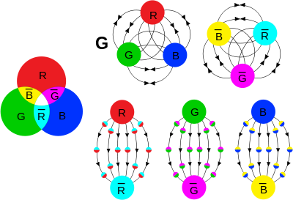

What is Quantum ChromoDynamics (QCD)?
QCD is the theory describing strong force interactions through color-charged particles (quarks)
The strong force holds together protons and neutrons
Color is a quantum number
Quarks come in three colors; red, blue, green
Antiquarks come in three anticolors; antired, antiblue, antigreen
Gluons generate a color change for quarks (for the more advanced SU_{c}(3)), but they also can self interact (unlike photons in E&M)

Slide 12
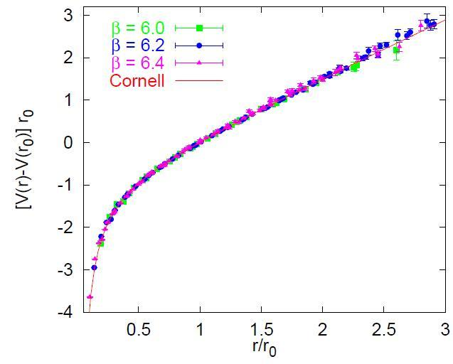
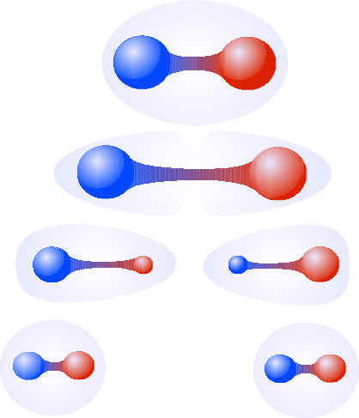
Solitary Confinement...plus a friend or two
Unlike photons in QED, the strong force does not get weaker the further apart two quarks are. It gets stronger!
This property means an infinite amount of energy would be required to remove a quark from a proton
This has led to the confinement hypothesis, which states that color-charged particles cannot be isolated (i.e. no singlet states). They must only exist in color-neutral bound states.
Coupling with the gluon field is ~5x10⁵ times larger than coupling with the photon field...

Slide 13
Solitary Confinement...plus a friend or two
Unlike photons in QED, the strong force does not get weaker the further apart two quarks are. It gets stronger!
This property means an infinite amount of energy would be required to remove a quark from a proton
This has led to the confinement hypothesis, which states that color-charged particles cannot be isolated (i.e. no singlet states). They must only exist in color-neutral bound states.
Coupling with the gluon field is ~5x10⁵ times larger than coupling with the photon field...well sometimes

Slide 14

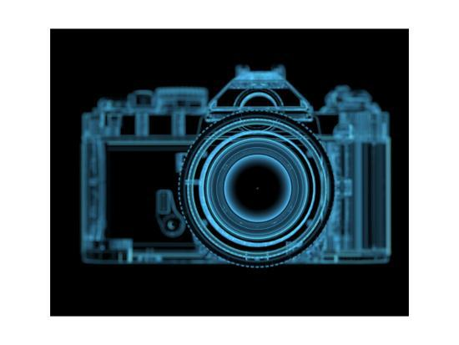
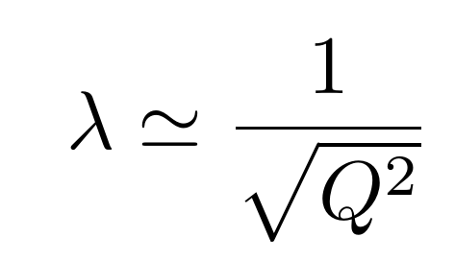
Coming to a finer resolution
QCD and QED are both relativistic quantum gauge-field theories which have the property that nothing is constant
Beloved quantum mechanical cornerstones are now dynamic, including charge distribution, mass, and even the number of particles
This means that what you see depends on the wavelength of the probe used
Think about the wavelength of light for a photo vs. a xray
This also means the strength of the force depends on the resolution, a so called mass-scale
Momentum transfer

Slide 15
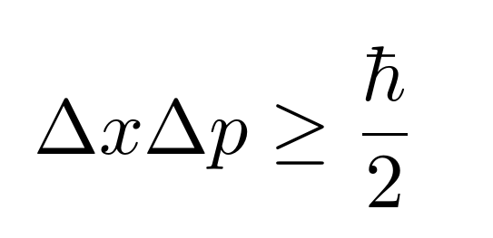
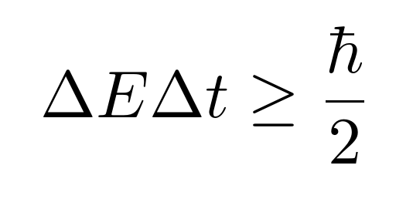
Dynamical Nature of QCD
The dynamical nature of QCD also affects what we know as a “quark”
The uncertainty principle can be viewed as an inequality of energy and time
Nearly infinite energies can exist as long as they disappear incredibly fast
This is how virtual particles arise in quantum field theories
But now in QCD these virtual particles (virtual quarks and gluons) interact with the valence quarks that make up a proton
Probing at different scales we can see three distinct “quark” types
At ~30% the fractional longitudinal momentum of the proton (a variable called x) we see the valence quarks
At ~10% we see a cloud of pions where the valence quarks are hidden in. (Partons we call them)
At ~1% we see the singlet quarks and gluons

Slide 16
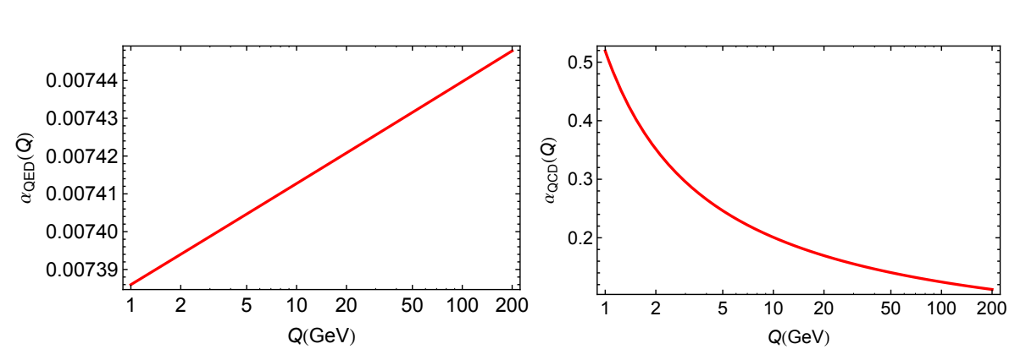
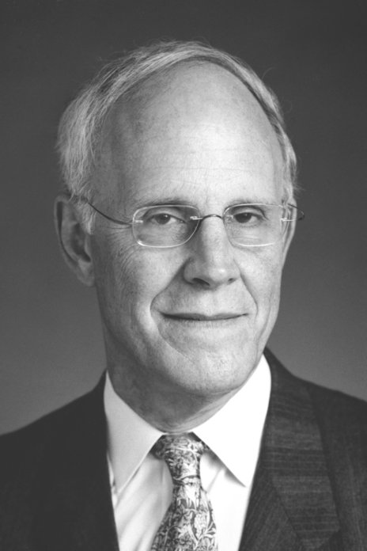

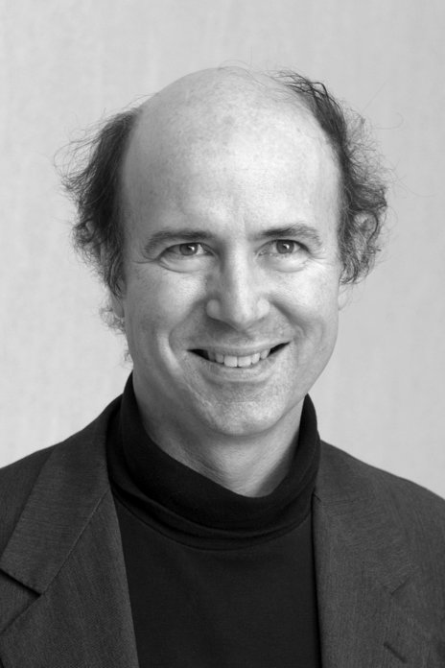
Asymptotic Freedom
At a higher mass-scale, the strong force asymptotically falls off. A feature known as asymptotic freedom.
This allows QCD to be studied perturbatively at high energies
Finding the onset of hard (perturbative QCD, pQCD) and soft (non-perturbative QCD) factorization is of critical importance in medium to high-energy physics
A scaling behavior in the parton model should show a dependence on transferred momentum (Q²) at higher order corrections

Slide 17
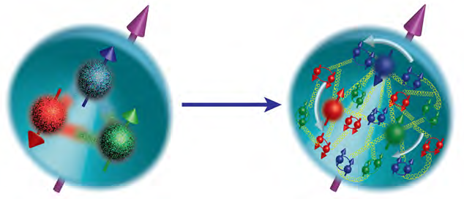
Summary of QCD
QCD is characterized by two emergent phenomena:
confinement
dynamical chiral symmetry breaking (DCSB)
The bound state degrees of freedom can be viewed through two lenses
Hadrons at large distance scales
Partons at small distance scales
This transition from hadronic to partonic degrees of freedom is required to characterize hadrons ab initio
Upgraded and new facilities, like Jlab and the EIC, will provide data to shed light on these transitions and guide theory models

Slide 18
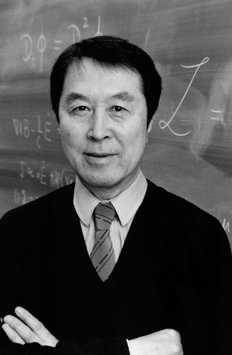
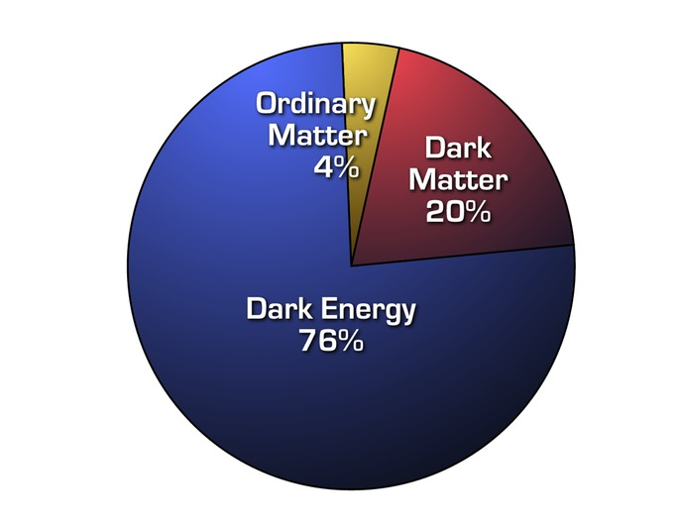
Dynamical Chiral Symmetry Breaking
But what is Dynamical Chiral Symmetry Breaking (DCSB)???
Higgs boson gives valence quarks mass
This only contributes <1% the proton mass
Where does the rest of the mass come from? Well, DCSB!
This means that 98% of all visible matter comes from DCSB!
This is because of a spontaneously broken symmetry, chirality (left and right “handedness”)
The best way to study DCSB is primarily through the pion (and as we will subsequently the kaon)
Chiral symmetry requires the pion to be partnered with a scalar meson of equal mass
There is no evidence for the existence of such a particle
No other properties of chiral symmetry are apparent in nature so the symmetry must be broken

Slide 19
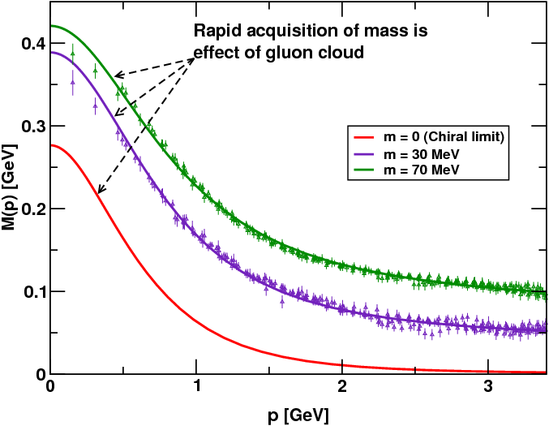
Pion Mysteries
The pion consists of an up quark and down antiquark so it is the simplest system to study light quarks, but also has many other unique properties
The pion’s mass is just a fifth what is expected in quantum mechanics
This can be contributed to symmetry constraints imposed by DCSB
These constraints lead to cancellations by (negative) gluon binding effects
This makes the pion a pseudo Nambu-Goldstone boson
All this means that finding the origin of the proton’s mass is the same as asking why the pion is so light, which is the connection between confinement and DCSB

Slide 20
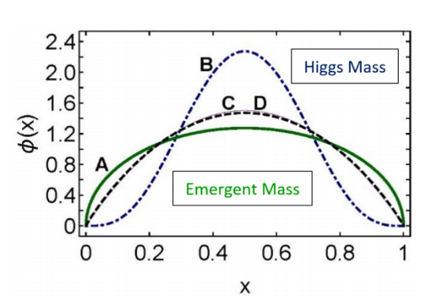
What a Strange World!
What about heavier quark bound states?
The data suggests that heavier flavor quark mass is primarily generated through the Higgs mechanism
The kaon sits in a unique position because its quark composition is both light and heavy
The kaon consists of an up quark and a strange antiquark
A competition seems to arise between DCSB and the Higgs mechanism
The kaon is also a pseudo Nambu-Goldstone boson which makes it a prime candidate for deeper DCSB studies

Slide 21
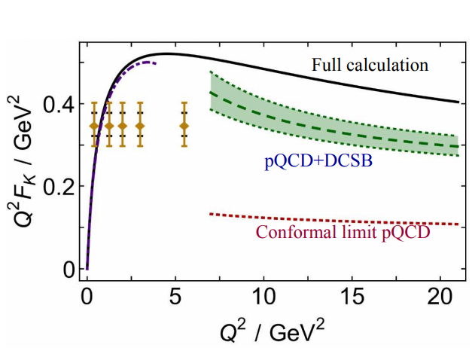
Meson Form Factors at Jlab
Clearest case for studying transition from non-perturbative to perturbative regions
Jlab 6 GeV data showed form factor differs from hard QCD calculation
Evaluated with asymptotic valence-quark Distribution Amplitude (DA), but large uncertainties
12 GeV form factor extraction data require:
measurements over a range of t, which allow for interpretation of kaon pole contribution
kaonLT
Notes:
At some point asymptotic freedom begins and this is where FF flattens out (i.e. no Q2 dependence). The scaling is where this flattens out to, because it depends on how Q2 scales leading to asymptotic freedom

Slide 22
What is the Form Factor?
Point-like cross section
We want a way to see how quarks are distributed in the pion/kaon
QED is well understood so we exploit the charge of quarks
There are two types of form factors used
Electric form factor (G_{E}), charge
Magnetic form factor (G_{M}), current
The form factor is the fourier transform of the transverse spatial charge density
1D function dependent on the transferred momentum (Q²)
We can get the form factor from the cross-section
Form Factor
kaonLT
Notes:
Fig. 1: Integrating over the fractional momentum x, one obtains the form factors.
Fig. 2: Even in the chiral limit the onset of quark mass would be present

Slide 23
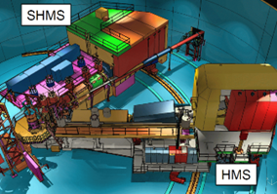
Review E12-09-011 (KaonLT) Goals
First kaon experiment at high enough energies for non-perturbative studies
Need very high precision, which only focusing spectrometers can do
SHMS in Hall C was built for this purpose
Q² dependence will allow studying the scaling behavior of the separated cross sections
t-dependence allows for detailed studies of the reaction mechanism
Contributes to understanding of the non-pole contributions, which should reduce the model dependence
If warranted by data, extract the kaon form factor

Slide 24
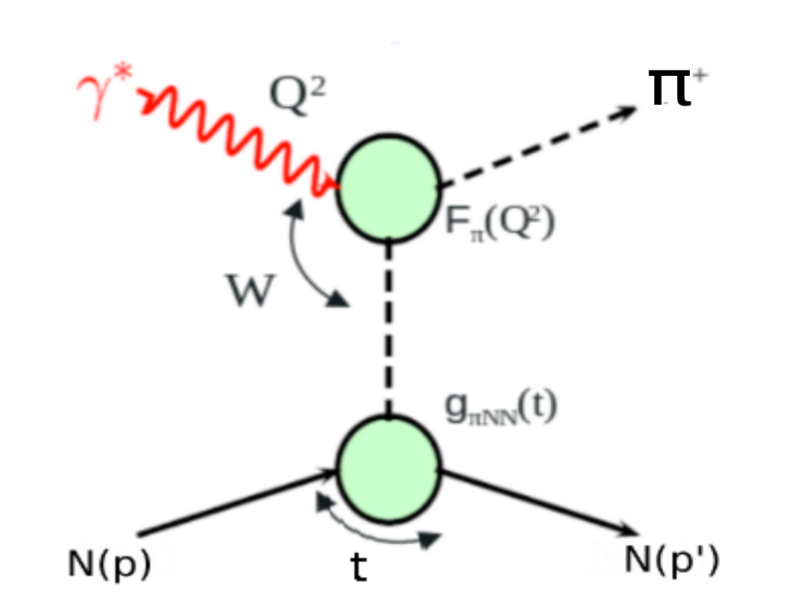
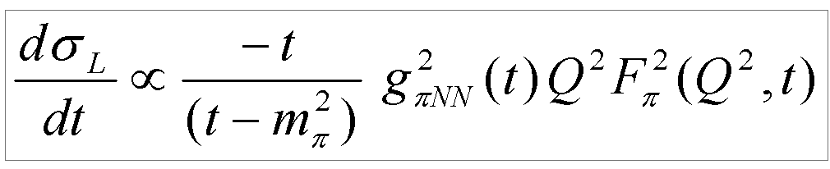
Experimental Determination of the π/K⁺ Form Factor
At larger Q², F_{ⲡ+}² must be measured indirectly using the “pion cloud” of the proton via the p(e,e’𝜋⁺)n process
At small –t, the pion pole process dominates 𝜎_{L}
In the Born term model, F_{ⲡ+}² appears as
Pole comes from the fact that π/K⁺ are not real (i.e. pion cloud), but can be treated as real if the pole dominates σ_{L} at small t
This is needed for validation that the form factor can be extracted
For the same Q² values, one can fit several σ_{L} values for different virtual photon polarizations (ε).
Notes:
And for the same Q2 values, one can fit several cross section values for different epsilon values

Slide 25
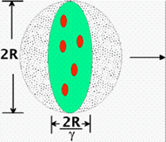
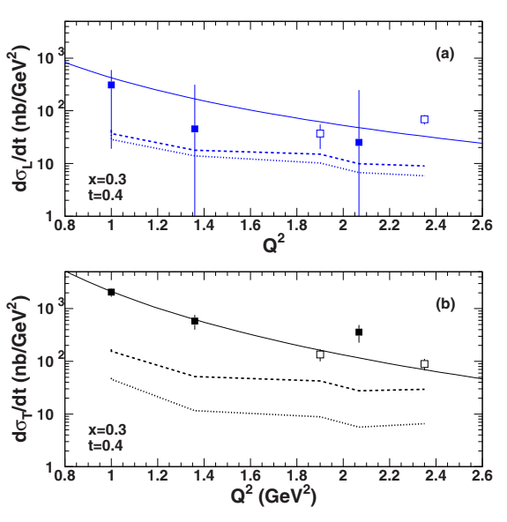
Hard-Soft Factorization
The K⁺ electroproduction cross section has a Q² dependence at fixed x and -t
Factorization of 𝜎_{L} scales to leading order Q⁻⁶
In that regime expect 𝜎_{T} to go as Q⁻⁸ and consequently 𝜎_{L}>>𝜎_{T}
Important because partons are “frozen” transversely in the reference frame of pQCD (i.e. infinite momentum frame)
Separated cross sections over a large range in Q² are essential for:
Testing factorization and understanding dynamical effects in both Q² and –t kinematics
Interpreting non-perturbative contributions in experimentally accessible kinematics
M. Carmignotto et al., PhysRevC 97(2018)025204
Notes:
At sufficiently high Q2, the process should be understandable in terms of the “handbag” diagram – can be verified experimentally

Slide 26

Jefferson Lab Continuous Electron Beam Accelerator Facility (Jlab CEBAF)
1995-2012:
Energies 0.4-6.0 GeV
200 μA, 85% polarization
Simultaneous beam delivery to 3 halls
A
C
B
Notes:
At sufficiently high Q2, the process should be understandable in terms of the “handbag” diagram – can be verified experimentally

Slide 27
Jefferson Lab Continuous Electron Beam Accelerator Facility (Jlab CEBAF)
D
1995-2012:
Energies 0.4-6.0 GeV
200 μA, 85% polarization
Simultaneous beam delivery to 3 halls
2016-:
Energies 0.4-12.0 GeV
150 μA, 85% polarization
Simultaneous beam delivery to 4 halls
Hall C
A
C
B
Notes:
At sufficiently high Q2, the process should be understandable in terms of the “handbag” diagram – can be verified experimentally

Slide 28


Exclusive K⁺ Electroproduction
p(e, e′K⁺)Λ(Σ⁰)
Scattering Plane
Incident electron, k
Virtual photon, q
Scattered electron, k’
The incident electron scatters off the proton at an angle θ_{e}.
Reaction Plane
Kaon, p_{K}
The kaon ejectile scatters at angle θ_{Kq}
The remaining proton energy (now a hyperon), p_{Λ(Σ)}
φ_{Kq} is the azimuthal angle between the planes
The exclusive products are the scattered electron and Kaon, while the missing hyperon mass is calculated explicitly

Slide 29

L/T Separation Basics
σ_{L} is isolated using the Rosenbluth separation technique
Measure the cross section at two beam energies and fixed W, Q², -t
A high and low ε value
Full azimuthal coverage, φ, will eliminate the interference terms
Simultaneous fit using measured azimuthal angle (φ) allows for extracting L, T, LT, and TT
σ_{L} -> slope
σ_{T} -> y-intercept
σ_{L} will give us F²_{K+}
T. Horn et al., PhysRevC 97(2006)192001
Notes:
Spectrometer acceptance, kinematics, and efficiencies

Slide 30

L/T Separation Example
Left [ -2° to -3° ]
Center [ 0° ]
Right [ +2° to +3° ]
Three SHMS angles for azimuthal (φ) coverage to determine the interference terms (LT, TT)
Using the two beam energies (ε) to separate longitudinal (L) from transverse (T) cross section
Fit using measured ε and φ dependence
Notes:
Right low epsilon setting is impossible because we’d run into the beam pipe

Slide 31

Kaon LT - Data Collected
The p(e, e′K⁺)Λ,Σ⁰ experiment ran in Hall C at Jefferson Lab over the fall and spring.
E (GeV) | Q² (GeV²) | W (GeV) | x | ε_{high}/ε_{low}
10.6/8.2 | 5.5 | 3.02 | 0.40 | 0.53/0.18
10.6/8.2 | 4.4 | 2.74 | 0.40 | 0.72/0.48
10.6/8.2 | 3.0 | 3.14 | 0.25 | 0.67/0.39
10.6/6.2 | 3.0 | 2.32 | 0.40 | 0.88/0.57
10.6/6.2 | 2.115 | 2.95 | 0.21 | 0.79/0.25
4.9/3.8 | 0.5 | 2.40 | 0.09 | 0.70/0.45

Slide 32


Experimental Details
Hall C: k_{e}=3.8, 4.9, 6.4, 8.5, 10.6 GeV
SHMS for kaon detection :
angles, 6 – 30 deg
momenta, 2.7 – 6.8 GeV/c
HMS for electron detection :
angles,10.7 – 31.7 deg
momenta, 0.86 – 5.1 GeV/c
Particle identification:
Dedicated Aerogel Cherenkov detector for kaon/proton separation
Four refractive indices to cover the dynamic range required by experiments
Heavy gas Cherenkov detector for kaon/pion separation

Slide 33



SHMS small angle operation
Some issues with opening and small angle settings at beginning of run
SHMS at 6.01°
HMS at 12.7°
[12/17/18]
SHMS
HMS
SHMS
HMS
Work of many people ...

Slide 34



KaonLT Event Selection
Isolate exclusive final states through missing mass
Coincidence measurement between kaons in SHMS and electrons in HMS
simultaneous studies of KΛ and KΣ⁰ channels…and a few others…
Kaon pole dominance tests through
Should be similar to ratio of coupling constants g²_{pKΣ}/g²_{pKΛ} in t-channel
Plot by R. Ambrose, S. Kay, R. Trotta

Slide 35





Comparison of high and low ε [Q²=3.0, W=2.32, x=0.40]
[10.6 Gev (high ε), 6.2 Gev (low ε)]
Left (θ_{high}=21.18,θ_{low}=16.28)
10.6 GeV (high ε)
6.2 GeV (low ε)
t
t

Slide 36


Comparison of high and low ε [Q²=3.0, W=2.32, x=0.40]
[10.6 Gev (high ε), 6.2 Gev (low ε)]
Left (θ_{high}=21.18,θ_{low}=16.28)
10.6 GeV (high ε)
6.2 GeV (low ε)
Pion
leakthrough
Pion
leakthrough

Slide 37




Comparison of high and low ε [Q²=3.0, W=3.14, x=0.25]
[10.6 Gev (high ε), 8.2 Gev (low ε)]
Center (θ_{high}=9.42,θ_{low}=6.89)
10.6 GeV (high ε)
8.2 GeV (low ε)
t
t

Slide 38


Comparison of high and low ε [Q²=3.0, W=3.14, x=0.25]
[10.6 Gev (high ε), 8.2 Gev (low ε)]
Center (θ_{high}=9.42,θ_{low}=6.89)
10.6 GeV (high ε)
8.2 GeV (low ε)
Notes:
Mystery bump, proton leak through HG center?

Slide 39




Comparison of high and low ε [Q²=3.0, W=3.14, x=0.25]
[10.6 Gev (high ε)]
Right (θ_{high}=6.65)
10.6 GeV (high ε)
t

Slide 40


Comparison of high and low ε [Q²=0.5, W=2.40, x=0.09]
[4.9 Gev (high ε), 3.8 Gev (low ε)]
Center (θ_{high}=8.86,θ_{low}=6.79)
4.9 GeV (high ε)
3.8 GeV (low ε)
Sitting on large pion
background
Sitting on large pion
background

Slide 41
Analysis Phases
Calibrations ✔
Calorimeter, aerogel, HG cer, HMS cer, DC, Quartz plan of hodo
Assure we are replaying to optimize our physics settings
Efficiencies and offsets
Luminosity, elastics, Heeps, etc.
First iteration of cross section
Bring everything together
Fine tune
Fine tune values to minimize systematics
Repeat previous step
Repeat until acceptable cross sections are reached
Possible attempt at form factor extraction
Fit the data to a model and iterate
Current Phase
Notes:
Point out heep

Slide 42


Phase 1: Timing Windows
Applying cuts should be done only once reference time cuts are properly chosen.
See Carlos Yero paper for more info: https://hallcweb.jlab.org/doc-private/ShowDocument?docid=1028
TDC coincidence spectra are the outputs from the L1ACC pre-triggers. The cuts are applied to the raw TDC spectra first.
Remove all cuts to the raw spectra to see the entire raw spectrum including background
Then subtract the background surrounding the peaks in order to clean the spectrum up a bit.
SHMS ¾ Raw (channels)
SHMS ¾ ref time corrected (ns)
SHMS ¾ Raw (channels)
SHMS ¾ ref time corrected (ns)
Notes:
TDC not raw is reference time corrected

Slide 43





Phase 1: Detector Calibrations
The online calibrations of the HMS cherenkov, SHMS HGCer, aerogel, and HODO were determined to be satisfactory for our current analysis.
Future calibrations will be completed on run by run basis
HMS Cer
SHMS Hodo
SHMS Aerogel

Slide 44


Phase 1: Drift Chamber Calibrations
HMS
Calibrating the chambers in each spectrometer is identical.
Performance of the drift chambers is very sensitive to the gas mix within the chamber.
This gas mix is in turn dependent upon environmental conditions
Purpose of the drift chamber calibration is to find the correct parameters to convert the recorded drift times to drift distances for each wire
For the KaonLT and PionLT experiments, it was decided that a new calibration would be produced for every experimental shift
roughly every 8 hours
Drift Distance
HMS
Residual
Notes:
Drift distance distributions for each plane should be flat
“Residuals” for each plane should be a narrow peak centred at 0 since the residual is a measure of the difference between the final position for a track and the hit location
obtained from each individual chamber.

Slide 45

Phase 1: Calorimeter Calibrations
Purpose of the calibration is to correctly convert the detected ADC signal from the calorimeter into an equivalent energy.
Calibration script utilises electron events to perform the calibration.
Many iterations were performed for all adequate runs
Notes:
the normalised energy peak (Edep/P)
the plot of the normalised energy as a function of δ(∆P ) is a relatively straight line barring a few minor wiggles at high δ

Slide 46
Phase 2.1: Importance of Luminosity Runs
Singles
E (GeV) | Q² (GeV²) | W (GeV) | x | Target | Current (uA) | ε_{high} | ε_{low}
10.6 | 5.5 | 3.02 | 0.40 | LH2,C | 5,15,30,45,50,55 | 0.53
10.6 | 3.0 | 3.14 | 0.25 | LH2,C | 50,70 | 0.67
6.2 | 3.0 | 2.32 | 0.40 | LH2,C | 5,15,30,50,65,70 |  | 0.57
Careful evaluations of the systematic uncertainties is important due to the 1/𝜺 amplification in the 𝜎_{L} extraction
Spectrometer acceptance, kinematics , and efficiencies are the primary contributors

Slide 47
Phase 2.1: Importance of Luminosity Runs
COIN
E (GeV) | Q² (GeV²) | W (GeV) | x | Target | Current (uA) | ε_{high} | ε_{low}
10.6 | 5.5 | 3.02 | 0.40 | LH2,C | 5,15,30,45,50,55 | 0.53
8.2 | 5.5 | 3.02 | 0.40 | LH2,C | 10,25,40,45,60 |  | 0.18
8.2 | 4.4 | 2.74 | 0.40 | LH2,C | 5,15,30,45,50,65 |  | 0.48
10.6 | 3.0 | 3.14 | 0.25 | LH2,C | 50,65,70 | 0.67
Singles: 17 runs
COIN: 50 runs (set singles+coin)
Plus PionLT runs!

Slide 48


Previous luminosity/tracking analysis
Singles luminosity scans has been previously looked out with online data
Relative yield has been reduced to ~2% spread for carbon target
Early on tracking efficiencies were a big contributor
At a given ¾ rate, HMS tracking efficiency is ~4% higher than that of the SHMS
HMS tracking efficiency is mostly independent of kinematic setting – not the case for the SHMS
Many of these issues have been fixed after a in depth analysis of many groups
Analysis by D. Mack and R. Trotta
Notes:
Fixes to hcana but a critical aspect to focus on going forward

Slide 49



Phase 2.1: HGCer Challenges
Fall
Spring
(After readjustments)
y
y
A hole in the HGCer will allow unwanted pions and accidentals
An in depth analysis will be required for proper efficiency determination
This hole is already causing visible issues
x
x
Stephen Kay analysis
https://logbooks.jlab.org/entry/3676623
Notes:
Thought we’d be going to stockholm for

Slide 50
Phase 2.2: Heep Runs
E (GeV) | -P_{SHMS} (GeV) | -P_{HMS} (GeV) | Type | Target | Current (uA)
10.6 | 6.30-8.04 | 5.32-6.59 | Single+ COIN | LH2 | 10,15,30,35,40
8.2 | 4.35-5.75 | 4.35-5.75 | Single+ COIN | LH2 | 65,70
6.2 | 3.28-3.94 | 2.94-3.71 | Single+ COIN | LH2 | 25,50,65,70
4.9 | 2.58-4.64 | 2.58-4.37 | Single+ COIN | LH2 | 10,35,70
3.9 | 2.48-3.01 | 2.03-3.01 | Single+ COIN | LH2 | 50

Slide 51
Conclusion
QCD is the theory describing the internal working of the proton and neutron
Confinement and DCSB are the two emergent phenomena characterizing QCD
The pion, being a pseudo Nambu-Goldstone boson, is the cleanest way to further studies of DCSB
Kaon can provide an interesting way to expand previous data of charged pion form factor with access to the mechanism involving strangeness
E12-09-011 has completed its 2018-19 run
Potential to extract the Kaon form factor from the L/T separated cross sections to the highest Q² achievable at Jlab
Potential to provide much needed data for Q² scaling at fixed x and -t in Kaon electroproduction to validate QCD factorization for hadron imaging studies
Currently in the second phase of analysis

Slide 52
Extra Slides

Slide 53
Bringing it All Together
We discovered that (nearly) massless quarks and gluons make up the nucleon and that QCD governs their interactions.
We had hoped to find out how quarks and gluons and their interactions give rise to the characteristics of the nucleons.
Spin
Mass
We also hoped that we would be able to find out how nucleon-nucleon interactions work in terms of QCD.
How nuclear forces arise?
How do nuclear characteristics come about?
Need something beyond a 1D form factor description...

Slide 54

Meson Structure in 3D
Form factors are vital in understanding internal hadronic structure and dynamics
The 3D imaging of a nuclei uses Generalized Parton Distributions (GPDs) and Transverse Momentum-dependent parton Distributions (TMDs)
TMDs: Confined motion in nucleon (semi-inclusive DIS)
GPDs: Spatial imaging (exclusive DIS)
Requires…
High luminosity
Polarized beams and targets
Notes:
Fig. 1: Integrating over the fractional momentum x, one obtains the form factors.
Fig. 2: Even in the chiral limit the onset of quark mass would be present

Slide 55


Comparing π and K⁺ Form Factor
Large pion t data lies a similar distance from the pole as kaon data
The Born term model should be approximately valid for kaon form factor
The hard scattering limit in pQCD predicts a similar result
Requirements:
Full L/T separation of the cross section – isolation of σ_{L} (which requires σ_{L} >> σ_{T})
Selection of the pion pole process
Extraction of the form factor using a model
Validation of the technique - model dependent checks
Notes:
And for the same Q2 values, one can fit several cross section values for different epsilon values

Slide 56
Comparing π and K⁺ Form Factor
Large pion t data lies a similar distance from the pole as kaon data
The Born term model should be approximately valid for kaon form factor
The hard scattering limit in pQCD predicts a similar result
Requirements:
Full L/T separation of the cross section – isolation of σ_{L} (which requires σ_{L} >> σ_{T})
Selection of the pion pole process
Extraction of the form factor using a model
Validation of the technique - model dependent checks
Notes:
And for the same Q2 values, one can fit several cross section values for different epsilon values

Slide 57
Comparing π and K⁺ Form Factor
Large pion t data lies a similar distance from the pole as kaon data
The Born term model should be approximately valid for kaon form factor
The hard scattering limit in pQCD predicts a similar result
Requirements:
Full L/T separation of the cross section – isolation of σ_{L} (which requires σ_{L} >> σ_{T})
Selection of the pion pole process
Extraction of the form factor using a model
Validation of the technique - model dependent checks
Notes:
And for the same Q2 values, one can fit several cross section values for different epsilon values

